Slide 1


Sales & Financial Performance Summary

Slide 2

CONTENTS
1. Overview
2. Key Performance Indicators (KPIs)
3. Regional Performance
4. Product Analysis
5. Customer & Payment Trends
6. Profit vs Growth
7. Summary & Recommendations

Slide 3




1. Overview
Dataset Description
The dataset includes sales records from multiple regions (UAE, India, Saudi Arabia). It covers different products (Electronics, Furniture, Groceries). The dataset tracks Sales, Cost, Profit, and Growth.
1
Customer Segments
Retail and Corporate
2
Payment Methods
Online, Cash, Credit Card

Slide 4
2. Key Performance Indicators (KPIs)
KPI | Value | Insight
Total Sales | Sum of all Sales | Overall revenue generated
Total Profit | Sum of all Profits | Business earnings
Average Growth (%) | Mean of Growth | Overall sales growth trend
Profit Margin (%) | (Profit / Sales) × 100 | Profitability ratio
(You can show these in Power BI or Excel chart form.)

Slide 5
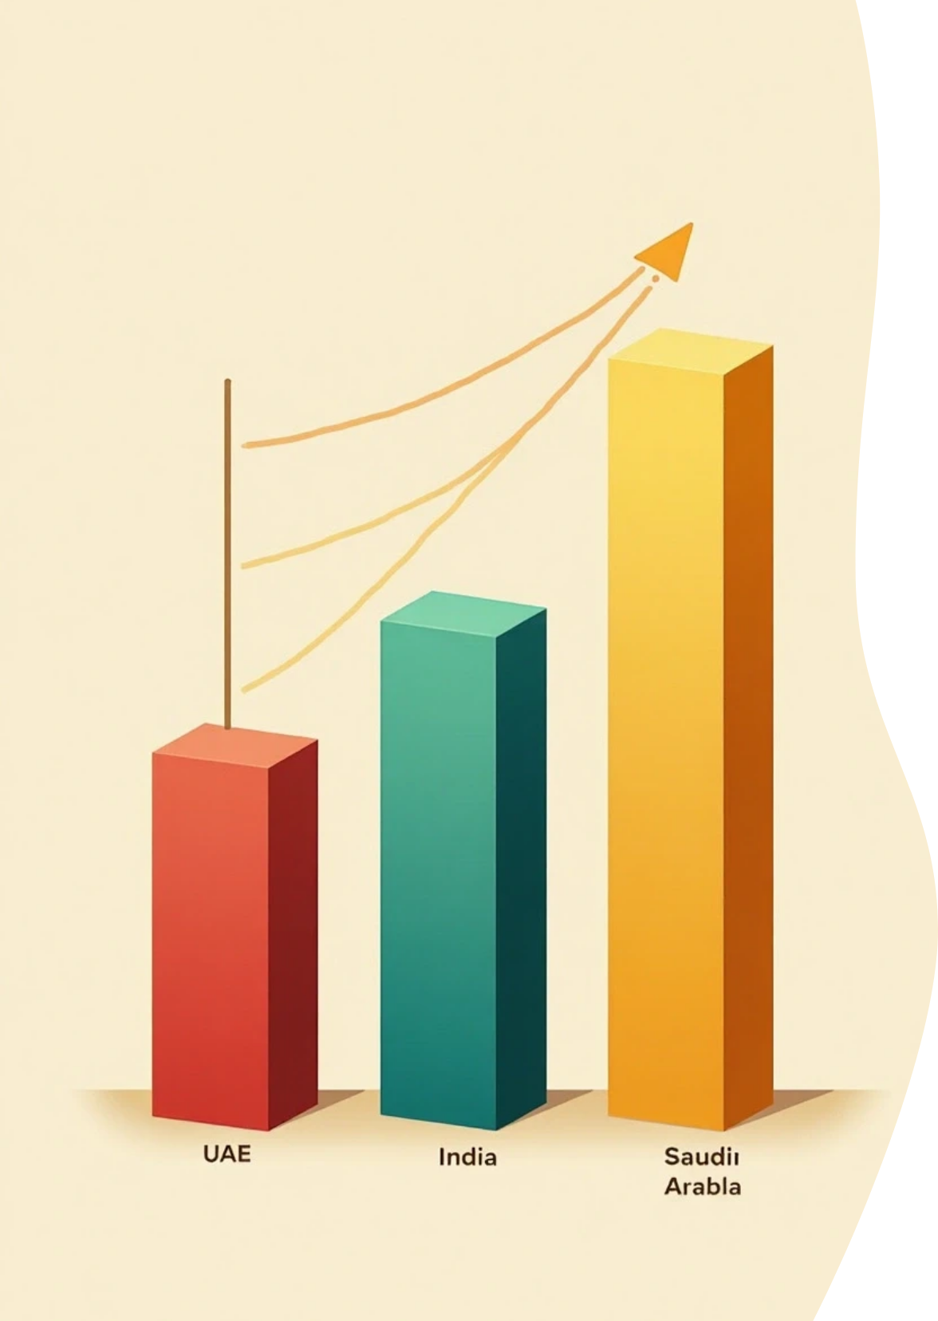




3. Regional Performance
Sales and Profit Analysis
1
Compare Sales and Profit by Region
• 🇦🇪 UAE – Strong sales in Groceries
• 🇮🇳 India – Consistent in Electronics
• 🇸🇦 Saudi Arabia – Moderate performance
2
Show with a bar or map chart in Power BI or PPT.

Slide 6


4. Product Analysis
Electronics: Highest total sales
Furniture: Lower profit margin
Groceries: Steady but smaller growth
Use a column or pie chart for product share.

Slide 7





5. Customer & Payment Trends
1
2
Customer Type
Payment Modes
Retail dominates sales count
Online and Credit Card preferred
This suggests growing digital payment adoption.

Slide 8


6. Profit vs Growth
Visualize using a scatter or line chart
Highlight:
• Positive growth but negative profit → needs cost optimization
• High profit, low growth → stable but not expanding

Slide 9




7. Summary & Recommendations
1
2
✅ Focus more on profitable product lines (Electronics)
✅ Improve Furniture segment cost control
3
4
✅ Strengthen online sales strategy
✅ Consider region-based marketing for UAE and India

Slide 10

Thank You

